Slide 1
Responsive design - (Day 2)
Viktoras Lava www.viktoraslava.lt

Slide 2
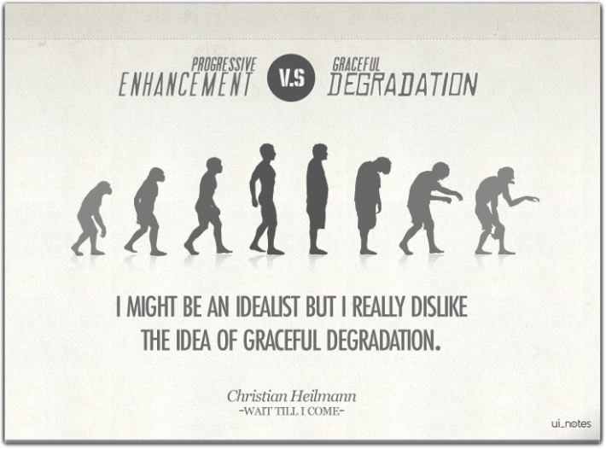
Responsive web development approaches
Today we will discuss two possible techniques on how to develop a responsive website:
Graceful degradation
Progressive enchancement

Slide 3

What is graceful degradation?
Graceful degradation is a web development approach to provide a certain level of user experience in modern browsers.
It will also degrade gracefully to a lower level of user experience in older browsers or lower performance devices.

Slide 4
When to use graceful degradation?
When you try to adapt an old website that wasn’t built for mobile devices
You don’t have time to finish a product with full responsive experience (bad sign of planning or running out of budget)
It makes more sense from business perspective to maintain a basic version rather than a full one

Slide 5
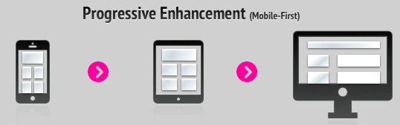
What is progressive enhancement?
Progressive enhancement is very similar, but it does things the other way around. You start by establishing a basic level of experience that all browsers or devices will be able to support and then you build in more advanced functionality.
Progressive enchancement is also called mobile-first approach.

Slide 6
When to use progressive enhancement?
You are trying to deliver a product that works in “every” browser or device
When a new feature becomes adopted you can enhance your website to another level, without having to touch the original solution
When you have a decent budget and time to deliver a product.

Slide 7
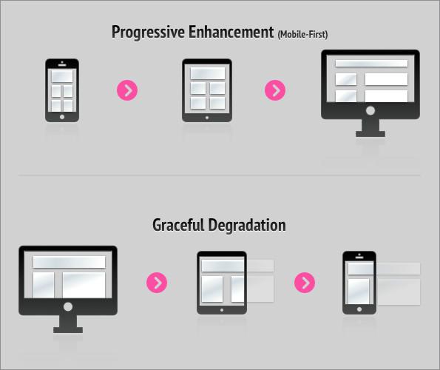
Graceful degradation vs progressive enhancement
Both progressive enhancement and graceful degradation try to keep our products useful to every user.
Progressive enhancement is more stable way of assuring that but it takes more time and effort. Graceful degradation can be used more easily as a patch for an already existing product; it means harder maintenance later on, but requires less initial work.

Slide 8
Questions?

